Slide 1

INTRODUCTION TO CLOUD
BY DILEEP JALLIPALLI

Slide 2
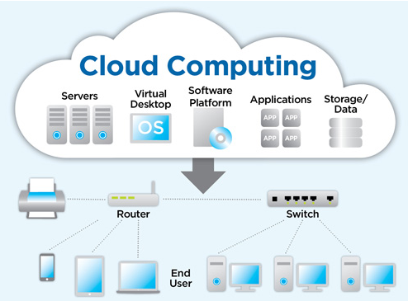
WHAT IS CLOUD COMPUTING?
The term cloud refers to Internet based computing or in other words ,on-demand availability of computer system resources or delivery of computing services-servers,storage,databases,network,software,analytics and more over the internet and follows “pay as u go” model.
For example :- Instead of running an e-mail program on your computer, you login in to a web e-mail account remotely. The software and storage for your account doesn’t exist on your computer ---it’s on the service’s computer cloud or on there own data centers.

Slide 3
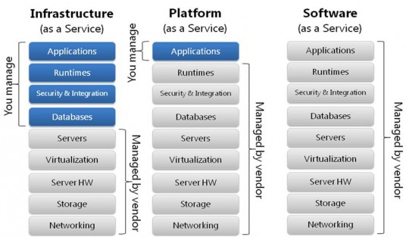
CLOUD COMPUTING SERVICE MODELS
IaaS -Infrastructure as a service (IaaS) is a cloud computing offering in which a vendor provides users access to computing resources such as servers, storage and networking.
PaaS-Platform as a service (PaaS) is a cloud computing offering that provides users with a cloud environment in which they can develop, manage and deliver applications. In addition to storage and other computing resources, users are able to use a suite of prebuilt tools to develop, customize and test their own applications
SaaS-Software as a service (SaaS) is a cloud computing offering that provides users with access to a vendor’s cloud-based software. Users do not install applications on their local devices. Instead, the applications reside on a remote cloud network accessed through the web or an API. Through the application, users can store and analyze data and collaborate on projects
.

Slide 4
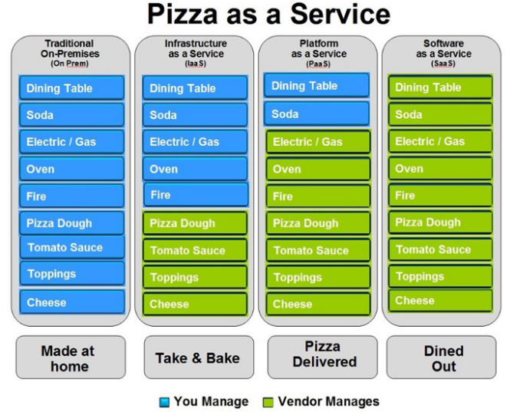
CLOUD COMPUTING SERVICE MODELS EXAMPLES
On Premise(Your own car)
PaaS(getting cab)
SaaS(hopping on bus)
IaaS(lending car)

Slide 5
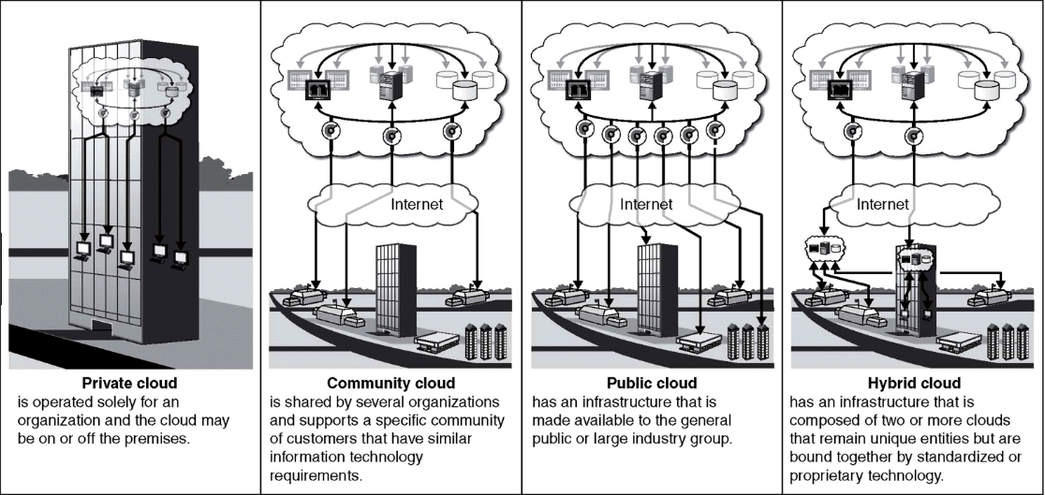
CLOUD DEPLOYMENT MODELS

Slide 6
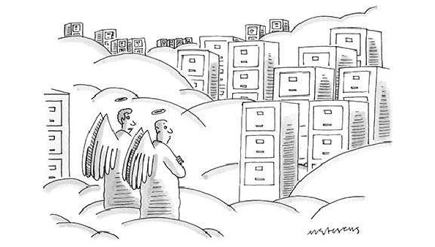
HOW WAS LIFE BEFORE CLOUD COMPUTING?
Procure hardware and software for hosting in datacentre
Multiple this effort for dozens of applications
Need team of experts to develop,install,configure and run
High cost and maintenance
To complete the setup it takes around couple of months

Slide 7
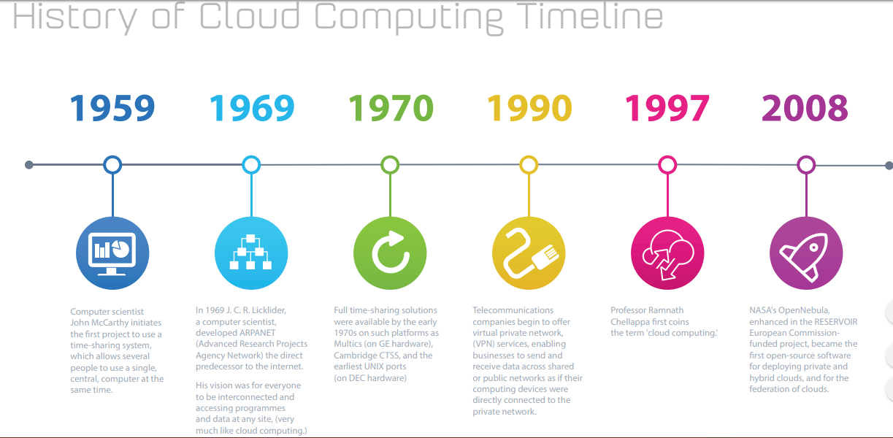

Slide 8
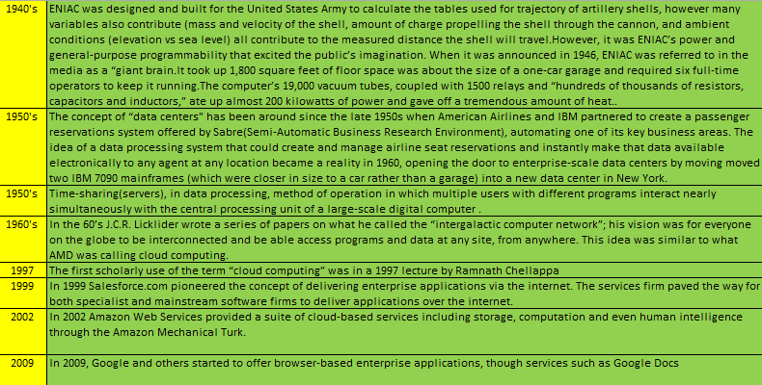
FLASHBACK

Slide 9
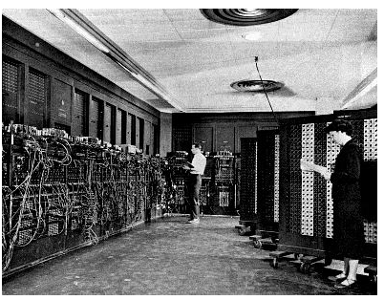

FLASHBACK
Programming ENIAC(Electronic Numerical Integrator And Computer),1946

Slide 10
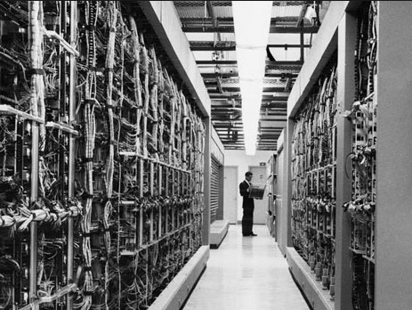

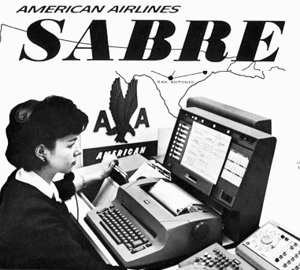
FLASHBACK
American Airlines and SABRE reservation system ,1960

Slide 11
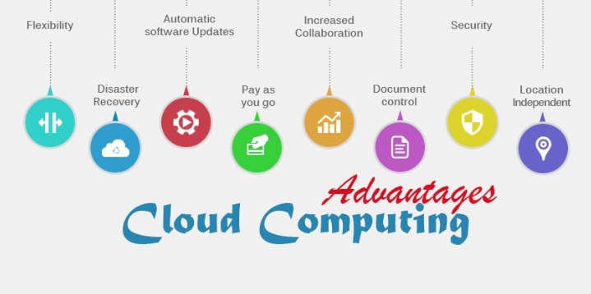
BENEFITS OF CLOUD COMPUTING

Slide 12
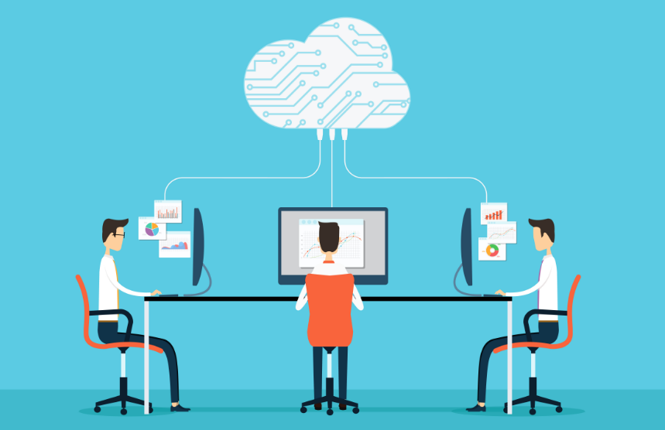

WHAT IS AMAZON WEB SERVICES?
Amazon Web Services (AWS) is a secure cloud services platform, offering compute power, database storage, content delivery and other functionality to help businesses scale and grow. Explore how millions of customers are currently leveraging AWS cloud products and solutions to build sophisticated applications with increased flexibility, scalability and reliability

Slide 13
HISTORY OF AWS
AWS platform was launched in July 2002, in the beginning ,the platform consisted of only few tools and services.
In late 2003 ,Chris Pinkham and Benjamin Black presented a paper describing a vision for Amazon's retail computing infrastructure that was completely standardized, automated and would rely extensively on web services. Suggested selling access to virtual servers as a service that could generate revenue from infrastructure investment and prepared a business case.
In November 2004,the first AWS service Simple Queue Service(SQS) was launched for public usage
Pinkham and lead developer Christoper Brown developed the Amazon EC2 service, with a team in Cape Town, South Africa
Amazon Web Services was officially re-launched on March 14, 2006,combining the three initial service offerings of Amazon S3 cloud storage, SQS, and EC2
2007 over 180,000 developers on the platform
2012 First re:invent Conference
To support industry-wide training and skills standardization, AWS began offering a certification program for computer engineers, on April 30, 2013, to highlight expertise in cloud computing
2014 committed to achieve 100% renewable usage for its global footprint
2016 run rate of $13 billion USD per annum
2017-2018 AWS re:invent releases a host of AI services as well as VR services

Slide 14
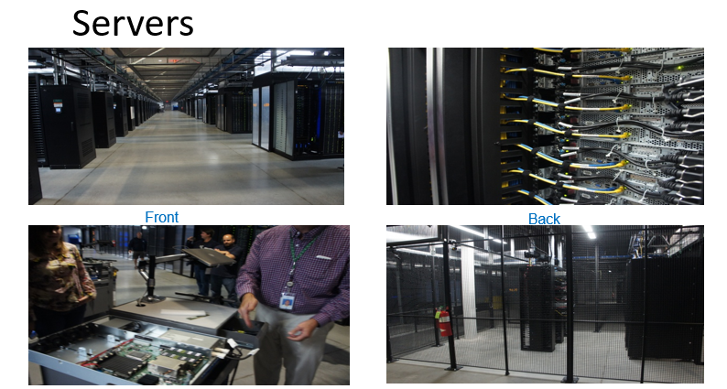

Slide 15
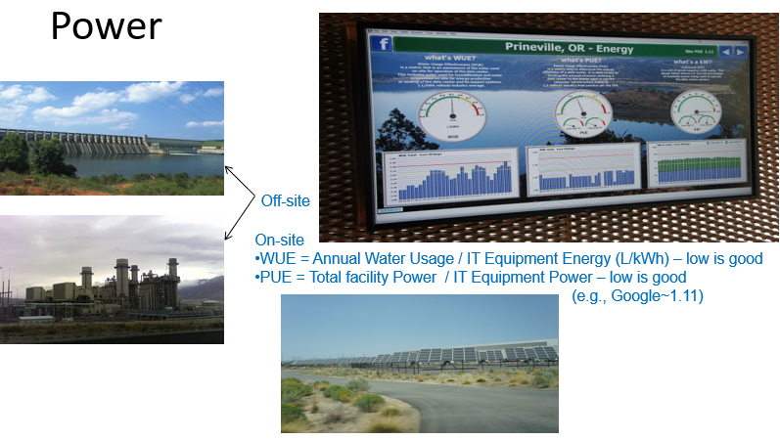

Slide 16
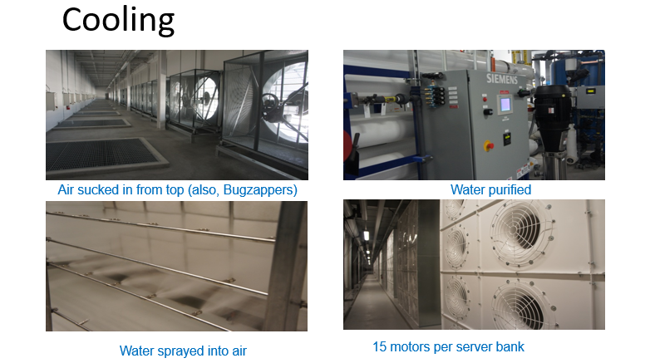

Slide 17
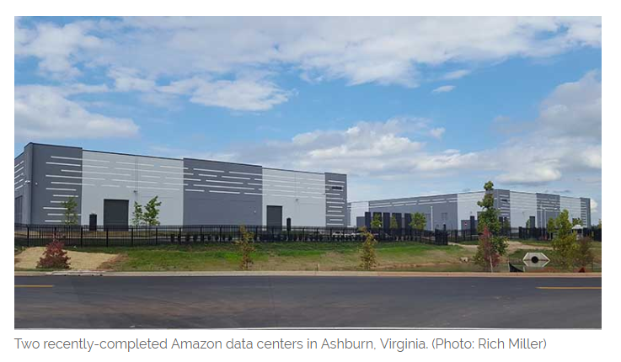
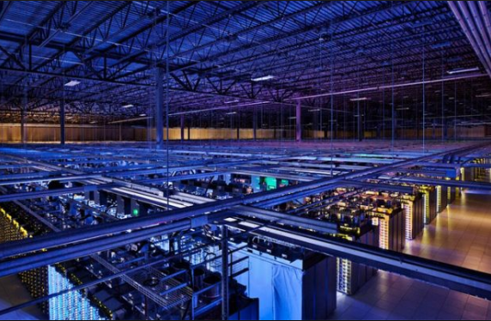
About 150,000 square feet
Amazon standardizes its data centres to house between 50,000 and 80,000 servers, according to company presentations. That consistent approach can seen in COPT's recent data centre projects, which typically come in two standard sizes of about 150,000 square feet or 215,000 square feet.( Nearly size of 4 football grounds)

Slide 18
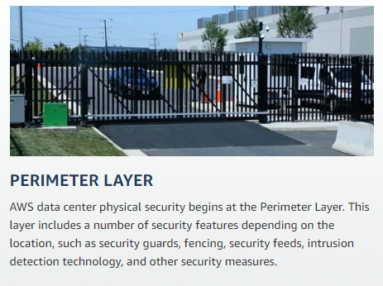

Slide 19
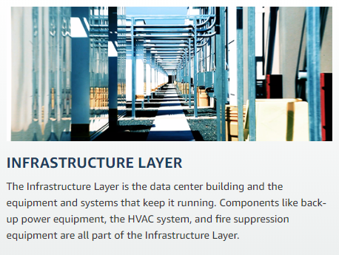

Slide 20
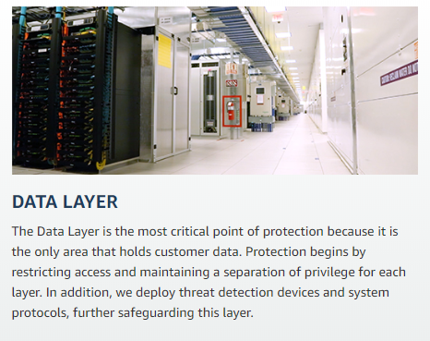

Slide 21
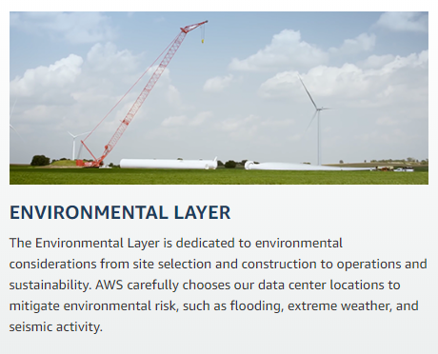

Slide 22
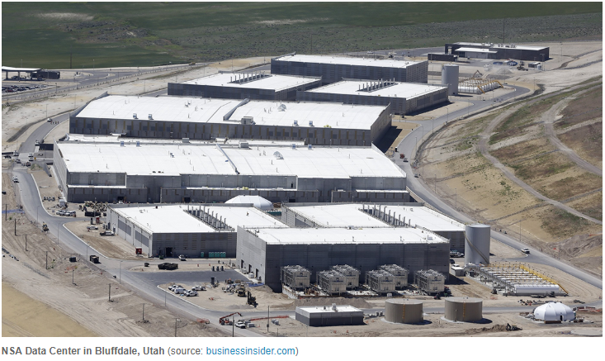
The Utah Data Center, also known as the Intelligence Community Comprehensive National Cybersecurity Initiative Data Center, is a data storage facility for the United States Intelligence Community that is designed to store data estimated to be on the order of exabytes or larger.

Slide 23
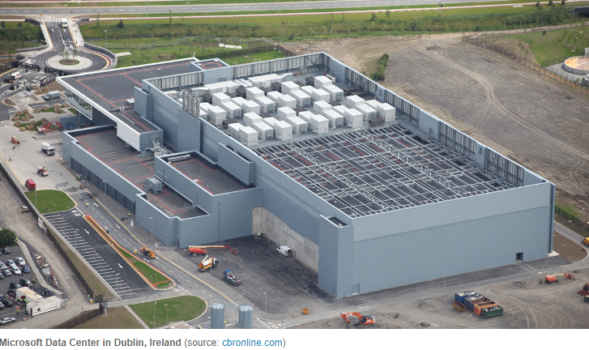
This new Tier 4 Data Centre development is located in Dublin on a 19 acre site. It is one of the largest Data Centers in Europe and has space for further expansion.

Slide 24
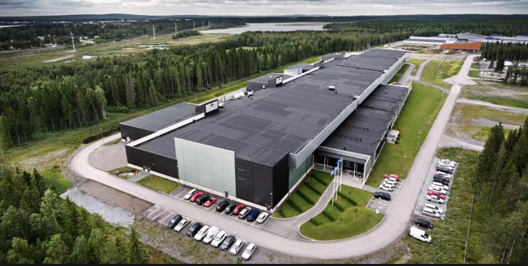
Facebook Data Center,Lulea,Sweden

Slide 25
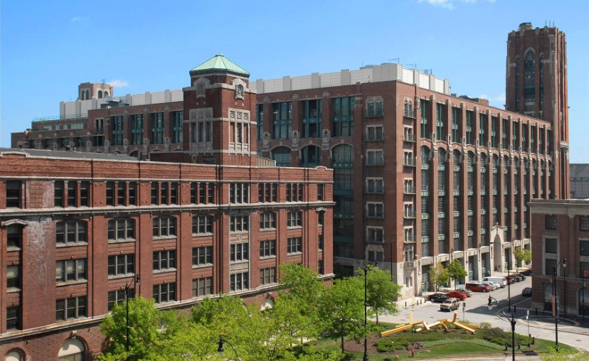
Lakeside Technology Center(Chicago), which is an epicenter for numerous diverse businesses counting Century Link, Facebook, and IBM. Owned by Digital Realty Trust, the Lakeside Technology Center is a hub having 1.1 million square feet data space located in Chicago. The huge data center is power backed up by around 50 generators to keep the data processing on track and avoid any kind of data outage.

Slide 26
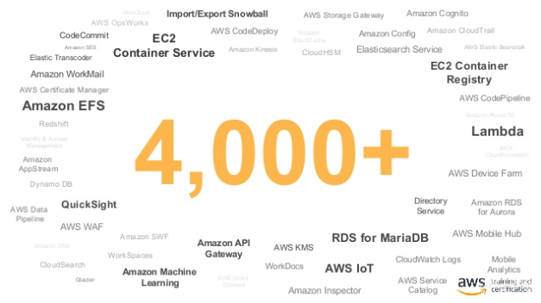

Slide 27
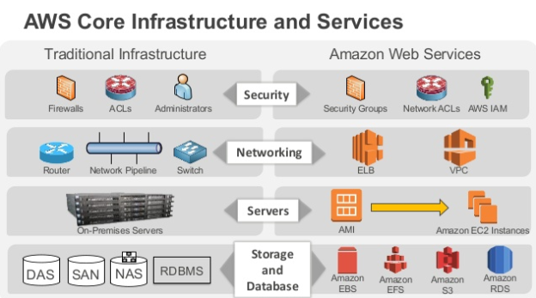

Slide 28
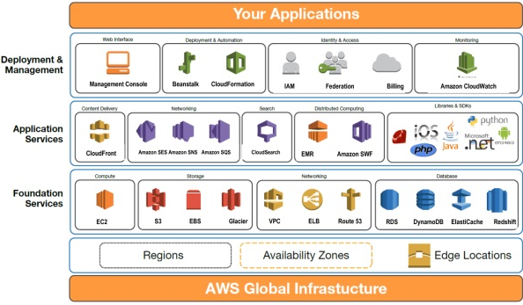

Slide 29
AWS GLOBAL INFRASTRUCTURE
AVAILABILITY ZONES & REGIONS

Slide 30
AWS GLOBAL INFRASTRUCTURE
The AWS Cloud spans 69 Availability Zones within 22 geographic regions around the world, with announced plans for 9 more Availability Zones and three more AWS Regions in Jakarta, Cape Town, Milan
AWS Regions
An AWS Region is a geographical location with a collection of availability zones mapped to physical data centers in that region. Every region is physically isolated from and independent of every other region in terms of location, power, water supply, etc.
This level of isolation is critical for workloads with compliance and data sovereignty requirements where guarantees must be made that user data does not leave a particular geographic region. Inside each region, you will find two or more availability zones with each zone hosted in separate data centers from another zone. The largest AWS region, us-east-1, has six zones(Northern Virginia)
AWS availability zones
An availability zone is a logical data center in a region available for use by any AWS customer. Each zone in a region has redundant and separate power, networking and connectivity to reduce the likelihood of two zones failing simultaneously. In fact, each zone is backed by one or more physical data centers, with the largest backed by five.
In each zone, participating data centers are connected to each other over redundant low-latency private network links. Likewise, all zones in a region communicate with each other over redundant private network links. These intra and inter-zone links are heavily used for data replication by a number of AWS services including storage and managed databases.

Slide 31
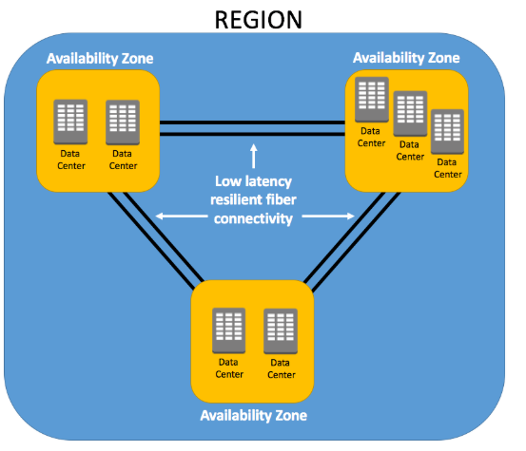

Slide 32
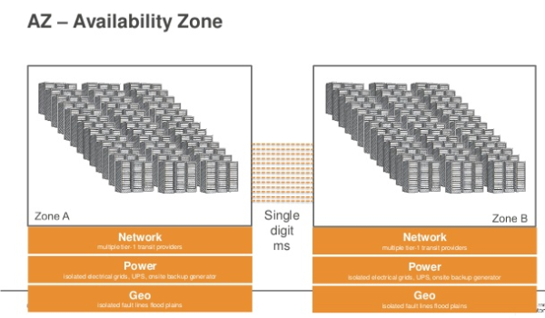

Slide 33
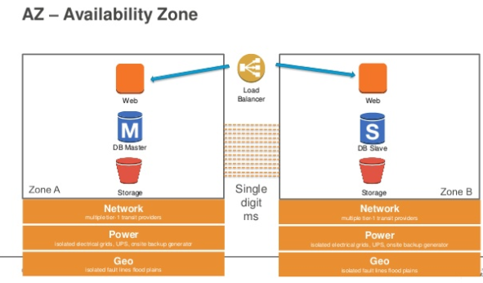

Slide 34
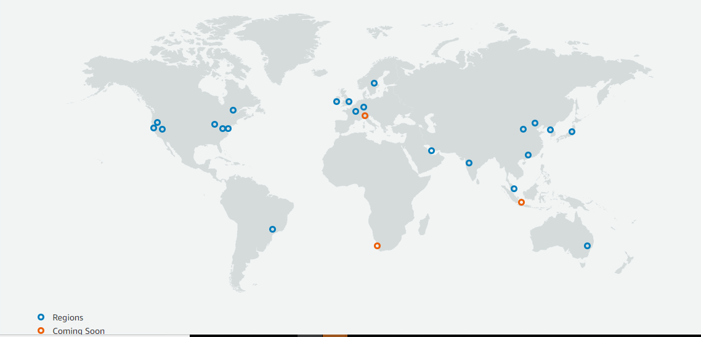
The AWS Cloud spans 69 Availability Zones within 22 geographic Regions around the world, with announced plans for 9 more Availability Zones and three more Regions in Cape Town, Jakarta, and Milan.

Slide 35
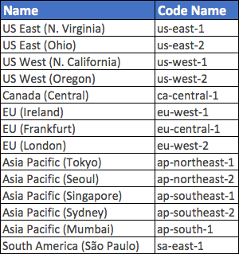
REGION AND AVAILABILITY ZONE NAMING CONVENTIONS
AWS has a specific naming convention for both Regions and Availability Zones. Depending on where you are viewing and using the Region name, it can be represented as two different names for the same Region. Regions have both a ‘friendly’ name, indicating a location that can be viewed within the Management Console and a Code Name that is used when referencing regions programmatically, for example when using the AWS CLI.

Slide 36
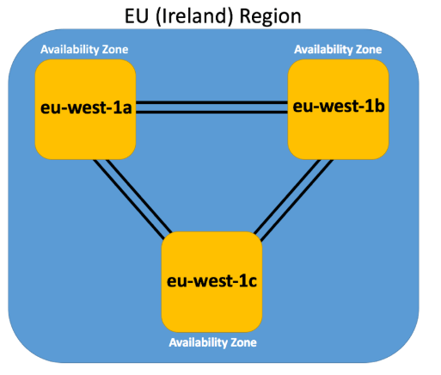
For example, the AZs within the eu-west-1 region (EU Ireland), are:
eu-west-1a
eu-west-1b
eu-west-1c

Slide 37
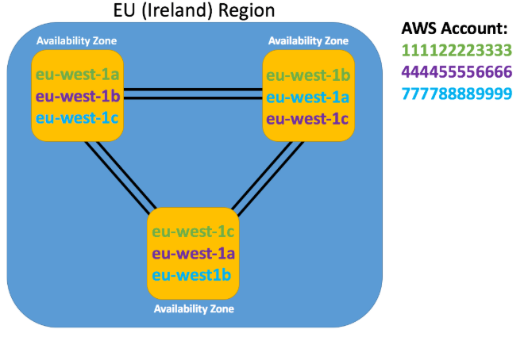
An interesting point to be aware of here is that AWS maps these AZ letter identifiers to different physical AZs for different AWS accounts. This ensures that there is a more even distribution of resources across all AZs within a Region.

Slide 38
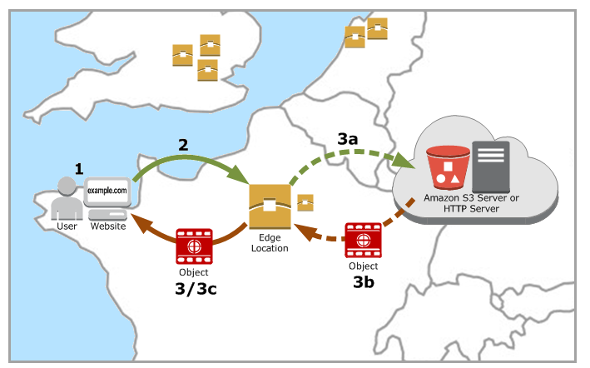
EDGE LOCATION
An edge location is where end users access services located at AWS. They are located in most of the major cities around the world and are specifically used by CloudFront (CDN) to distribute content to end user to reduce latency. It is like frontend for the service we access which are located in AWS cloud.
To deliver content to end users with lower latency, Amazon CloudFront uses a global network of 180 Points of Presence (169 Edge Locations and 11 Regional Edge Caches) in 69 cities across 30 countries.

Slide 39
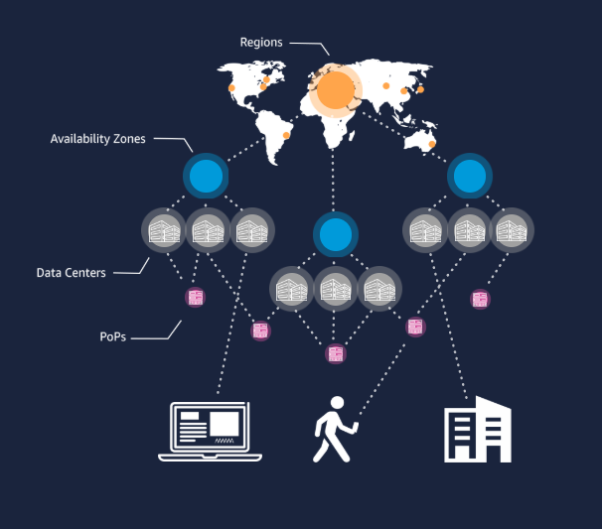

Slide 40
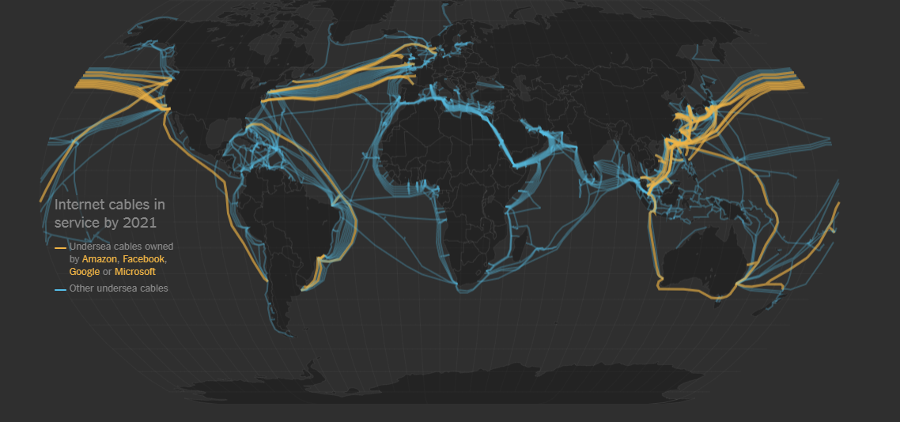
“People think that data is in the cloud, but it’s not. It’s in the ocean”

Slide 41

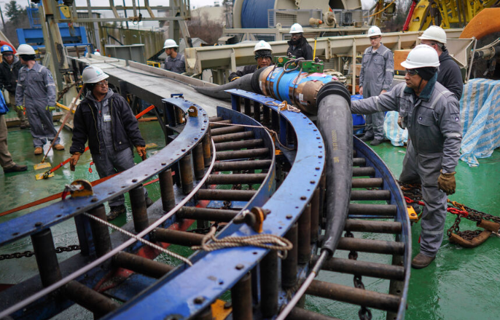
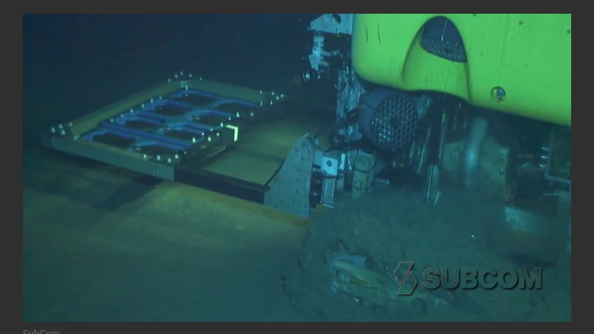


Slide 42

Cloud Computing is up to 40 times more cost-effective for a Small and Medium Business (SMB), compared to running an in-house IT system.
94% of SMBs have found security benefits in the cloud that they didn’t receive in their on-premises service
2014 was the first year when most of the workloads were on the Cloud computing environment.
70% of businesses have reported that they’ve been able to reinvest funds into their business by the virtue of using the cloud-computing technology.
By 2020, cloud computing will cross the $270 billion mark in investment
A new cloud web server is added for every 600 smartphones or 120 tablets in use
Banking sector performs their most of the actions using Cloud.
75% of businesses report that availability of service has improved since moving to the cloud
Approximately 64% of the businesses have lowered the electricity expenditure and misuse since they shifted to the Cloud environment.
80% of companies that adopt the cloud see improvements within their IT departments within six months
As part of the “cloud-first” policy, 48% of the U.S. Government agencies have begun using the cloud!
The survey conducted by Microsoft Corporation, around 62% repliers mentioned that the privacy level of their data has been increased because of moving to the cloud computing environment
It is anticipated that the public cloud solution will sense huge 44% growth by 2020
According to an estimate made by industry experts, by 2020, 40 Zettabytes of data will be held in the cloud; this is a really huge figure indeed

